Slide 1
Structured Query Language SQL - DDL
Recitation -2-
SQL Datatypes
DDL statements
Presented by:
Rakan A. Alseghayer

Slide 2
Database Languages
Data Definition Language (DDL):
Define schemas
Define Integrity Constraints
Example: unique SIDs
More…
Data Manipulation Language (DML):
To ask questions = Query
Example: Which students have GPA > 3.75?
To insert, delete and update data

Slide 3
Basic SQL-DDL COMMANDS
For database schemas:
CREATE SCHEMA, DROP SCHEMA
For tables:
CREATE TABLE, DROP TABLE, ALTER TABLE
For views:
CREATE VIEW, DROP VIEW
For integrity constraints
CREATE IC, DROP IC
For domains:
CREATE DOMAIN, DROP DOMAIN [SQL99]
For Indexes [defunct in SQL2]

Slide 4
Database Schema
CREATE SCHEMA <database-name> AUTHORIZATION <user-identifier>;
E.g. CREATE SCHEMA micro_db AUTHORIZATION panos;
DROP SCHEMA <db-name> [RESTRICT | CASCADE];
Restrict: removes the schema if the db has no data
Cascade: removes everything, data and definitions
E.g., DROP SCHEMA micro_db RESTRICT;

Slide 5
Schema and Catalog
SQL2, SQL3 support multiple database schemas
Catalog contains the definitions of database schemas
INFORMATION_SCHEMA
Schemas and Base relations (tables)
(tbl_name, creator, #of_tuples, tuple_length, #of_attributes…)
Attributes of Relations (columns)
(tbl_name, atrb_name, type, format, order, key_no, ...)
Authorization
Integrity
Indexes
Naming of tables: Schema_name.Table_name
Query: Describe table name; or using SELECT
Notes:
SELECT table_name FROM user_tables;
Describe table name;

Slide 6
Create Table
CREATE Table <Table-name> ( <Attribute-name> <Attribute-Type>, … Constraint <Constraint-name> <Constraint-spec>, … );
E.g.,
CREATE TABLE Students (
sid CHAR(20),
name CHAR(20),
psid INTEGER,
age INTEGER,
gpa REAL,
timestamp
Constraint Student_PK
PRIMARY KEY (sid) );

Slide 7
SQL Datatypes
Numeric
Fixed numbers, approximate numbers, formatted numbers
Character Strings
fixed & varying length, CLOBS [SQL99], foreign language
Bit Strings
fixed & varying length, BLOBS [SQL99]
Temporal Data
date, time and timestamp, intervals
NULL value valid for all types

Slide 8
SQL Numeric Data
Exact Numbers: Two integer types with different ranges:
INTEGER (or INT) and SMALLINT
The range of numeric types is implementation dependent
Approximate Numbers: Three floating point types:
FLOAT[precision], REAL, and DOUBLE PRECISION
Users can define the precision for FLOAT
The precision of REAL and DOUBLE PRECISION is fixed
Floating point numbers can be in decimal or scientific notation
Formatted Numbers: These are decimal numbers
DECIMAL(i,j), DEC(i,j) or NUMERIC(i,j)
i = precision (the total # of digits excluding decimal point)
j = scale (the # of fractional digits. The default is zero)
Notes:
Precision refers to the number of decimal or fractional digits to be stored.
Oracle does not have floats but only Number()
Truncation: towards 0
Rounding (business instead of Scientific)

Slide 9
SQL Character Strings
A character string is a sequence of printable chars
In SQL, a character string is denoted by enclosing it in single quotes: ‘Hello SQL’
Character strings types
Fixed length n: CHAR(n) or CHARACTER(n)
Varying length of maximum n: VARCHAR(n) or CHAR VARYING (n) -VARCHAR2(n) in Oracle
The default value of n is 1, representing a single character. Also, CHAR or CHARACTER
CLOBS(Size): Character Large Objects [SQL99]
size specified in kilobytes (K), megabytes (M), or gigabytes (G)
Notes:
Varchar2 in Oracle
Unicode characters in MySQL

Slide 10
SQL Character Strings
Concatenation operator: ||
'abc' || 'XYZ' results in 'abcXYZ'
Foreign-language characters (ISO-defined chars):
NATIONAL CHAR(n)
NATIONAL VARCHAR(n)
Notes:
Varchar2 in Oracle
Unicode characters in MySQL

Slide 11
SQL Bit Strings
Bit strings are sequences of binary digits, or bits
In SQL, a bit string is denoted by enclosing it in single quotes: B’0101100110’
Bit String types
Fixed length n: BIT(n)
Varying length of maximum n: VARBIT(n) or BIT VARYING (n)
The default value for n is 1
BLOBS (size): Binary Large Objects [SQL99]
size specified in kilobytes (K), megabytes (M), or gigabytes (G)
Notes:
So, BIT = BIT(1) = VARBIT(1) = VARBIT

Slide 12
SQL Temporal Data
DATE data type
TIME and TIMESTAMP data types
INTERVAL data type.
INTERVAL data type represents periods of time
Notes:
One of the first systems to incorporate date/TS temporal data types natively

Slide 13
Date and Time
DATE (10 positions) stores calendar values representing YEAR, MONTH, and DAY: YYYY-MM-DD
TIME defines HOURS, MINUTES, and SECONDS in a twenty-four-hour notation: HH:MM:SS
TIME(i) defines i additional decimal fractions of seconds: HH:MM:SS:ddd...d
TIME WITH TIME ZONE includes the displacement [+13:00 to -12:59] from standard universal time zone: HH:MM:SS{+/-}hh:mm
hh are the two digits for the TIMEZONE_HOUR and mm the two digits for TIMEZONE_MINUTE
TIMESTAMP represents a complete date and time with 6 fractions of seconds and optional time zone.
Notes:
E.g., 6:30 am local time in Greece can be represented as 06:30:00+02:00, whereas 6:30 local time on the East coast of the U.S. as 06:30:00-05:00.
Timestamp: ‘yyyy-mm-dd hh:mm:ss [{+/-}hh:mm] Some vendors allow any punctuation to be used: 98/12/31 11*30*45 or 98.12.31 11+30+45 or 98@12@31 11^30^45
Oracle & SQL Server have only DATE that is Timestamp and have no TIME type ??

Slide 14
Functions on Dates
All systems provide functions under different names
for constructing a date from strings or integers
for extracting out the month, day, or year from a date
for displaying dates in different ways
Examples,
CAST(string AS DATE) [SQL2: CAST(<value> AS <type>)]
e.g., CAST(‘2002-02-18' AS DATE)
MAKEDATE (int year, int month, int day) or DATE (int year, int month, int day)
e.g., MAKEDATE(1999, 12, 31)
EXTRACT (MONTH/DAY/YEAR FROM <date>) [SQL3]
YEAR(<date>), MONTH(<date>), DAY(<date>)
Notes:
Extract (Month from Date(2009, 9, 29))

Slide 15
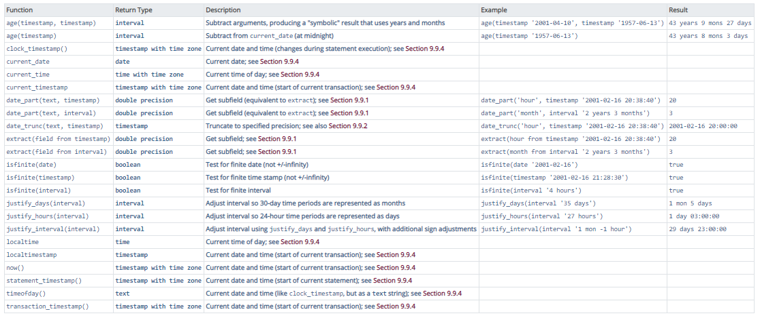
PostqreSQL Functions on Dates

Slide 16
Operations on Dates
Datetime (+ or -) Interval = Datetime
Datetime - Datetime = Interval
Interval (* or /) Number = Interval
Interval (+ or -) Interval = Interval
Examples (ANSI SQL):
(CURRENT_DATE + INTERVAL '1' MONTH)
(CURRENT_DATE - INTERVAL ‘18' DAY)
(CURRENT_DATE – BirthDate)
Notes:
Datetime - Datetime = Interval of year/month or day/time ?

Slide 17
Intervals
An interval results when two dates are subtracted. E.g., AdmitDate – DischargeDate
Two interval data types: Year-Month & Day-Time
Format: INTERVAL start-field(p) [TO end-field(fs)]
p is the precision (default is 2 digits)
fs is the fractional second precision, which is only applicable to DAY/TIME (default is 6 digits)
Year-Month intervals:
INTERVAL YEAR, INTERVAL YEAR(p), INTERVAL MONTH, INTERVAL MONTH(p), INTERVAL YEAR TO MONTH, INTERVAL YEAR(p) TO MONTH
E.g., INTERVAL YEAR (2) to MONTH could be [0-0, 99-11]
Notes:
p is the precision, or maximum number of digits in the leading field (default is 2 digits)
fs is the fractional second precision, which is only applicable to DAY/TIME (default is 6 digits)
In Oracle, default for fractions is 2: ff or
Interval Day to Second is [dd:hh:mm:ss:ff]

Slide 18
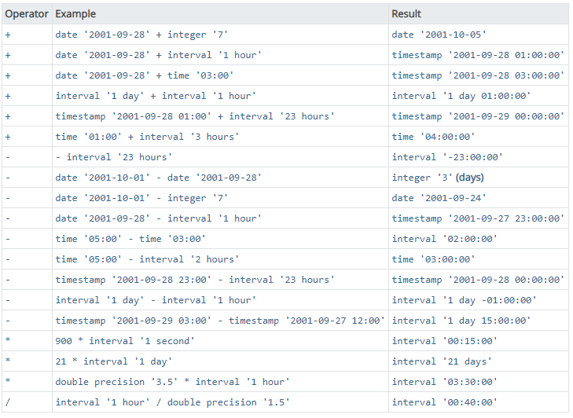
PostqreSQL Intervals…

Slide 19
DATETIME Type & Oracle DATE
DATETIME is not a valid ANSI SQL type
Not supported by Oracle - Oracle DATE = ANSI TIMESTAMP
MySQL DATETIME is used as a TIMESTAMP
MySQL DATETIME supported range is '1000-01-01 00:00:00' to '9999-12-31 23:59:59’
MySQL TIMESTAMP supported range is '1970-01-01 00:00:01' UTC to '2038-01-19 03:14:07' UTC
has varying properties, depending on the MySQL version and the SQL mode the server is running in.
Transarc-SQL: No TIMESTAMP
DATETIME: 1753-01-01 to 9999-12-31[hh:mm:ss:nnn]
DATETIME2: 0001-01-01 00:00:00.0000000 to 9999-12-31 23:59:59.9999999
Notes:
MS SQLServer support DATETIME similar to MySQL
UTC: Coordinated Universal Time

Slide 20
Observations on Numeric types
They are like the datatype in C
BIGINT for long integer or integer
Truncation is towards 0
Rounding is business instead of Scientific
[0..4] ↓ 0 [0..4] ↓ 0
[6..9] ↑ 1 [5..9] ↑ 1
Half times of 5 is 0 and half 1
Some systems use Number() for floating
Money or Currency data are numeric data with a currency sign: $, £, €, ¥

Slide 21
Constructing Date Functions in Oracle
Oracle | Returns
TO_CHAR(d,format) | character-string equivalent of d based on format
TO_DATE(s,format) | date corresponding to s based on format
TO_TIMESTAMP(s, format) | date corresponding to s based on format
Format | Description
MM | Month number
MON | 3-letter abbreviation of month
MONTH | Fully spelled-out month
D | Number of days in the week
DD | Number of days in the month
DDD | Number of days in the year
DY | 3-letter abbreviation of day of week
DAY | Fully spelled-out day of week
Y, YY, YYY, YYYY | Last 1, 2, 3 or 4 digits of year
HH12, HH24 | Hours of the day (1-12 or 0-23)
MI | Minutes of hour
SS | Seconds of minute
AM | Display AM or PM depending on time
Examples:
TO_DATE(‘2011-FEB-18’, ‘YYYY-MON-DD’)
TO_DATE(‘02182011’ , ‘MMDDYYYY’)
TO_CHAR(mydate, DY) → returns sun, mon, tue, wed, thu, fri, sat
Notes:
Section 1

Slide 22
Resolving Spec Ambiguity
TO_DATE(‘02182011’ , ‘MMDDYYYY’)
It parses to the longest keyword.
Examples:
'DYY' = DY and Y
TO_DATE('WED7', 'DYY') = 01-FEB-17
'DDDYYYY' = DDD and YYYY
TO_DATE('3232017', 'DDDYYYY') = 19-NOV-17
'DYYY' = DY and YY
TO_DATE('WED17', 'DYYY') = 01-FEB-17

Slide 23
Example of Date Functions
Oracle | SQLServer | MySQL | Returns
SYSDATE | CURRENT_TIMESTAMP GETDATE() | CURRENT_TIMESTAMP SYSDATE() NOW() | current date and time on the server
ADD_MONTHS(d,n) | DATEADD(datepart,n,d) | DATE_ADD(d,INTERVAL n u) DATE_SUB(d,INTERVAL n u) | d + n d – n n months after d
MONTHS_BETWEEN(d2,d1) | DATEDIFF(datepart,d1,d2) |  | d2 – d1 d2 – d1 in months
NEXT_DAY(d, weekday) |  |  | next date after d that falls on weekday
LAST_DAY(d) |  |  | last day of the month to which d belongs
datepart:
year,yy,yyyy,
quarter,qq,q,
month,mm,m,
dayofyear,dy,y,
day,dd,d,
week,wk,ww,
hour,hh,
minute,mi,n,
second,ss,s,
millisecond,ms

Slide 24
Example of Date Functions
Oracle | SQLServer | MySQL | Returns
SYSDATE | CURRENT_TIMESTAMP GETDATE() | CURRENT_TIMESTAMP SYSDATE() NOW() | current date and time on the server
ADD_MONTHS(d,n) | DATEADD(datepart,n,d) | DATE_ADD(d,INTERVAL n u) DATE_SUB(d,INTERVAL n u) | d + n d – n n months after d
MONTHS_BETWEEN(d2,d1) | DATEDIFF(datepart,d1,d2) |  | d2 – d1 d2 – d1 in months
NEXT_DAY(d, weekday) |  |  | next date after d that falls on weekday
LAST_DAY(d) |  |  | last day of the month to which d belongs
u (units):
SECOND
MINUTE
HOUR
DAY
MONTH
YEAR
DAY_HOUR
DAY_MINUTE
DAY_SECOND
HOUR_MINUTE
HOUR_SECOND
MINUTE_SECOND
YEAR_MONTH

Slide 25
Intervals…
DAY-TIME intervals: the fields can be a contiguous selection from DAY, HOUR, MINUTE, SECOND
E.g.,
INTERVAL DAY TO HOUR
[0:0, 99:23] (day:hours)
INTERVAL DAY(1) TO HOUR
[0:0, 9:23] (days:hours)
INTERVAL DAY TO MINUTE
[0:0:0, 99:23:59] (days:hours:minutes)
INTERVAL SECOND(8)
INTERVAL DAY(5) to SECOND(10)
INTERVAL MINUTE(3) to SECOND
Notes:
Second (10) = ss:ffffffff

